Slide 1
PowerShell Summit 2023
Notes:
Exceptions, Warnings, Errors, something all Sys Admins have to deal with as part of the there role.

Slide 2

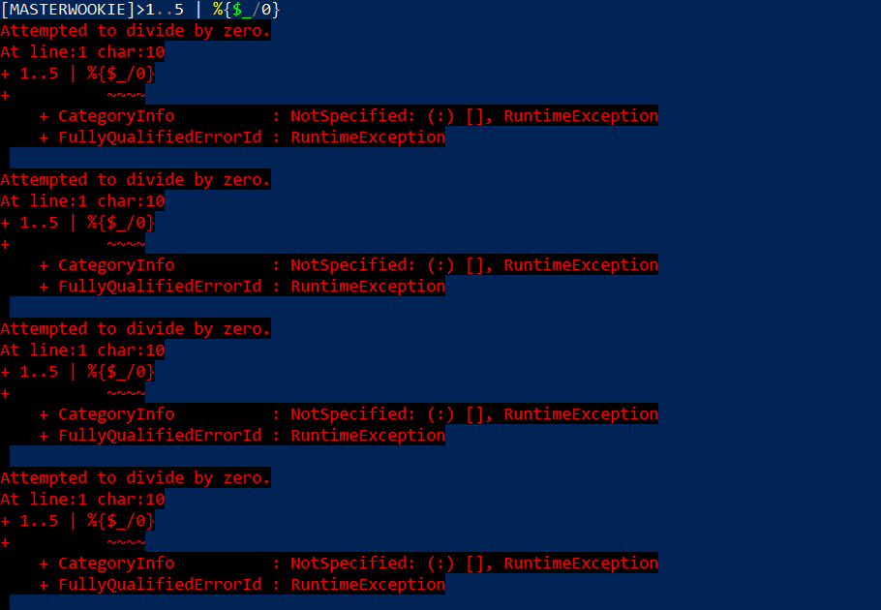
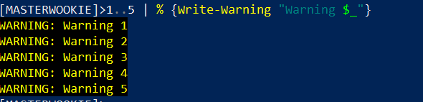
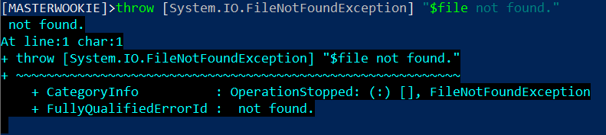
Errors, Warning, Exceptions Oh My!
Notes:
Errors, exceptions, and warnings, something every Systems administrator deals with daily. In fact, one evening while I was performing my oncall duties of manually logging on to an application that keeps track of ATM Transactions, the queue was well over the 150 transaction threshold, luckily at that time, we were performing an upgrade, which was causing the queue to back up temporarily until the upgrade completes.

Slide 3
PowerShell with SQL Statement Data Gathering?
Notes:
Why should you care and what benefit would you get from this?
You can look at the techniques I used at the company that I work for to solve a problem. This may not be the best option, I’m just providing an alternative option to the many tools you may already have available.
PowerShell 5.1/7.3

Slide 4
Agenda
LynxGate Automation Process
SQL Server Module
ITOpsVerification Module
Demo

Slide 5





Who is Bruce Stump
Systems Administrator
Teacher’s Credit Union
GitHub
LinkedIn
Twitter
Notes:
Star Wars Fan, so you may see some references to Star Wars.

Slide 6
Source Files for Presentation (GitHub)
https://github.com/bstump101/PowerShellWithSQLStatementDataGathering

Slide 7
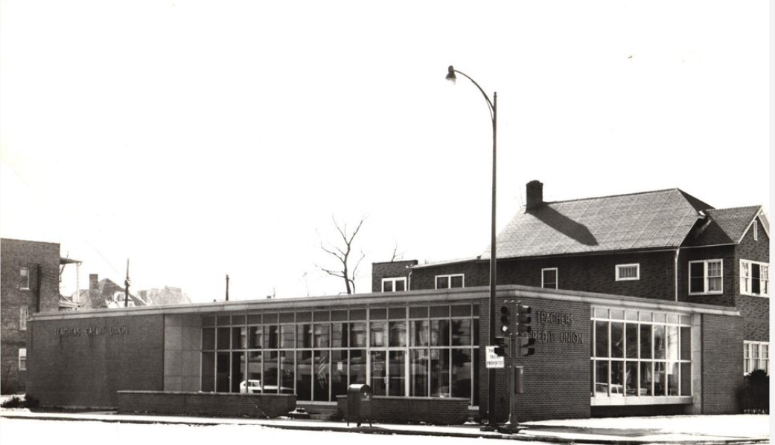
Teachers Credit Union is a not-for-profit financial institution in Indiana and southwest Michigan that was founded in 1931 in South Bend, Indiana.
https://www.tcunet.com/
Notes:
I’d also like to recognize my employer since they so gaceously help pay for my way to this conference.

Slide 8
Systems Administrator Role
Applications
Processes
Services
Databases
Networking
Etc.
What if service depends on transactional data?
Notes:
Systems Administrator where’s many hats. One task we perform is monitoring, what if we need specific data from database to determine if there is an issue.

Slide 9
Problem
Monitor ATM Transactions

Slide 10




Possible Solutions

Slide 11
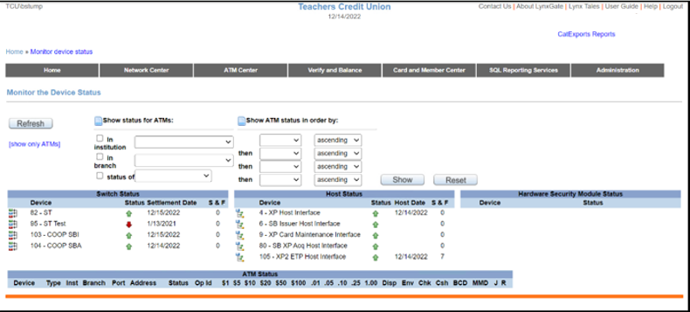
LynxGate Interface

Slide 12
SQL Server Module
Install-Module SQLServer
Import-Module SQLServer
Invoke-SqlCmd

Slide 13
ITOpsVerification Module
Contains LynxGate Cmdlets
Install-Module ITOpsVerification
Import-Module ITOpsVerification
Demo

Slide 14
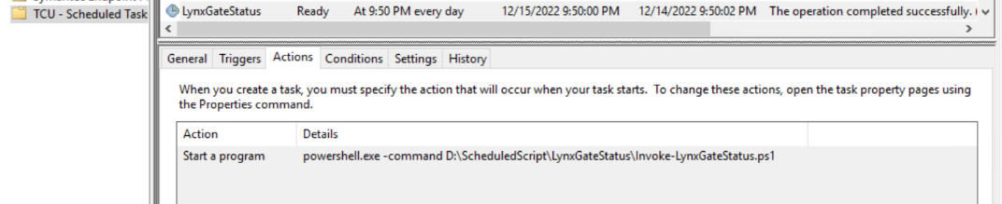
Scheduled Task – Actions

Slide 15
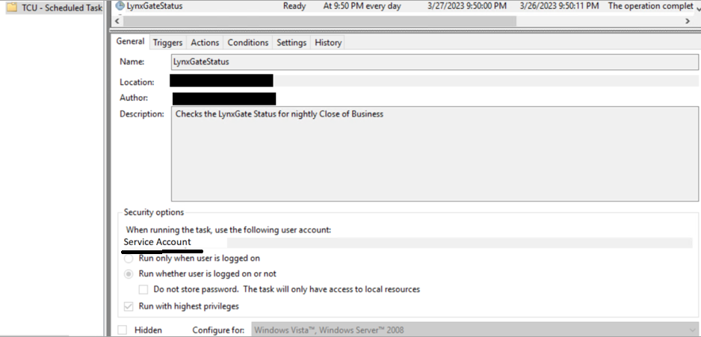
Scheduled Task - General
Notes:
Redacted some fields for security reasons.
Service Account – Password Never Expires, Read permissions to database table.

Slide 16
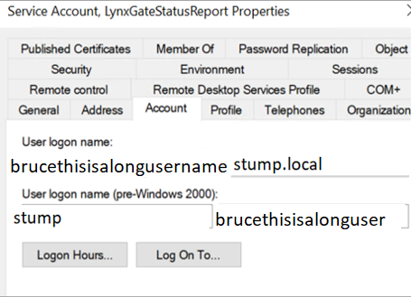
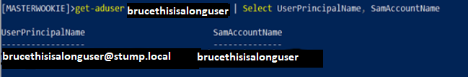

LynxGate Service Account
Notes:
New Logon Format
Old logon format = 20 characters

Slide 17
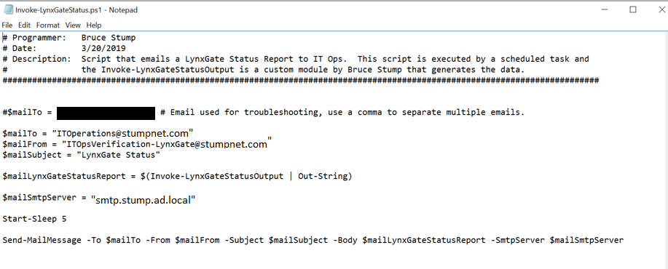
Invoke-LynxGateStatus.ps1
Notes:
Could of used splatting.

Slide 18
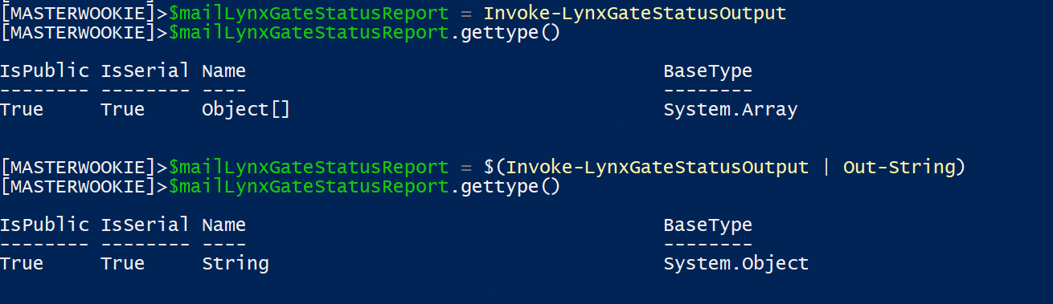
$mailLynxGateStatusReport

Slide 19
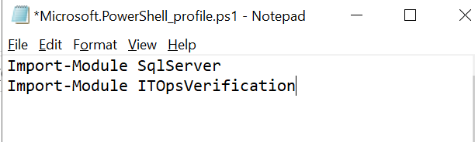
Profile
C:\Users\<Service Account Name>\Documents\WindowsPowerShell
Notes:
‘PowerShell’ folder for PowerShell version 7.x.

Slide 20
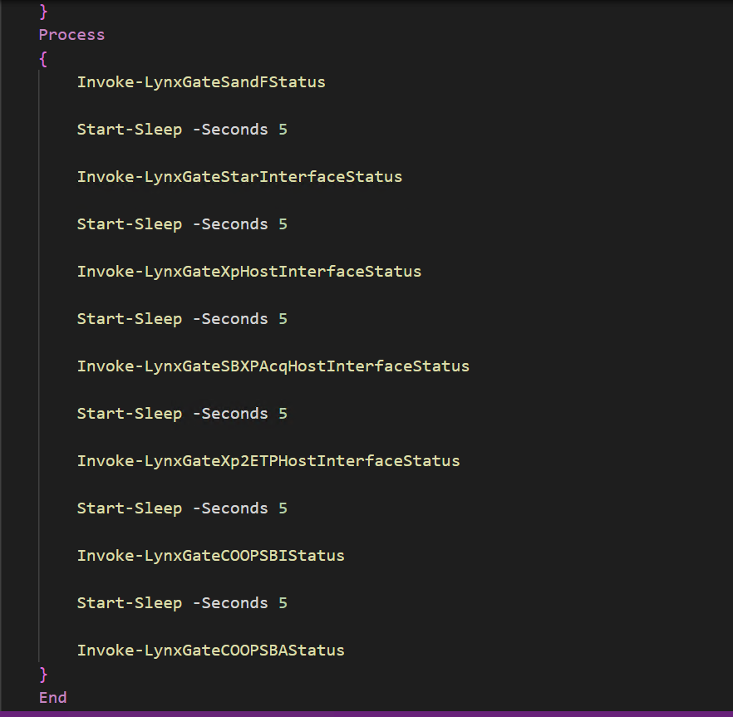
Invoke-LynxGateStatusOutput

Slide 21
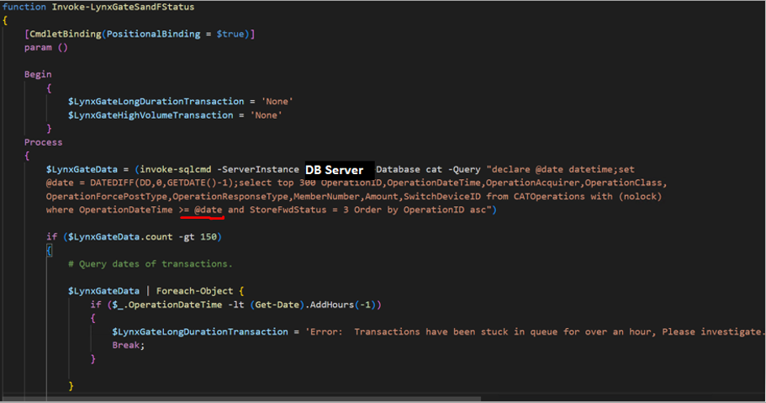
Invoke-LynxGateSandFStatus

Slide 22
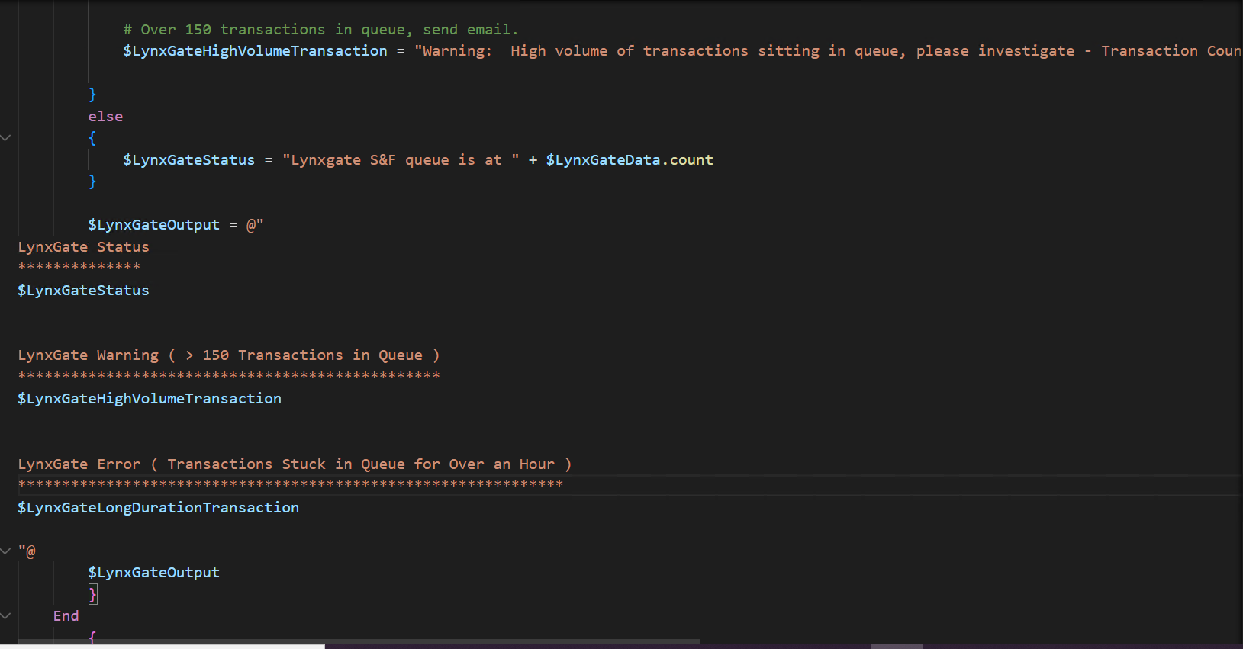
Invoke-LynxGateSandFStatus 2

Slide 23
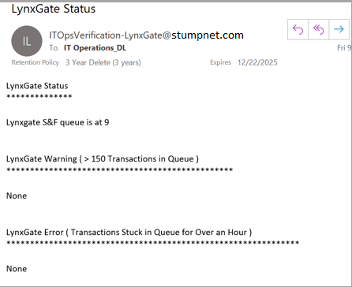
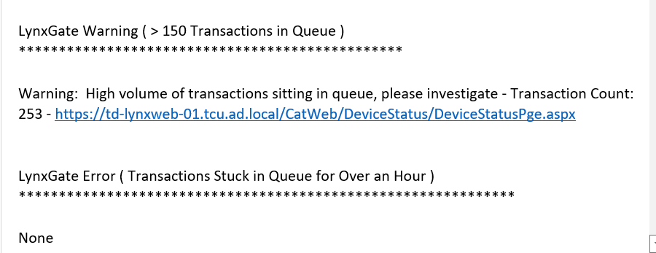
Invoke-LynxGateSandFStatus (Sample Email)

Slide 24
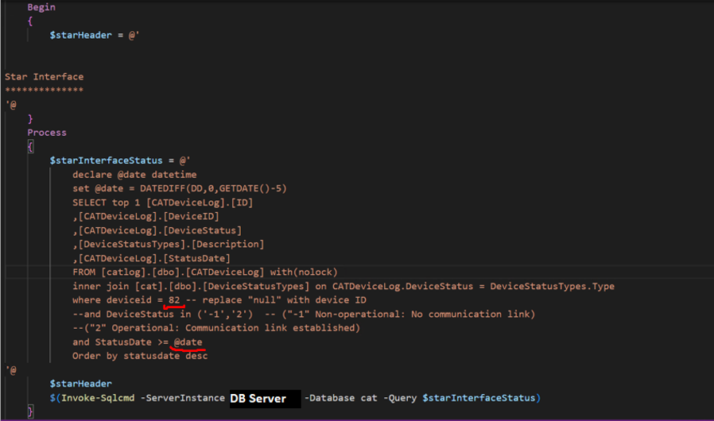
Invoke-LynxGateStarInterfaceStatus

Slide 25
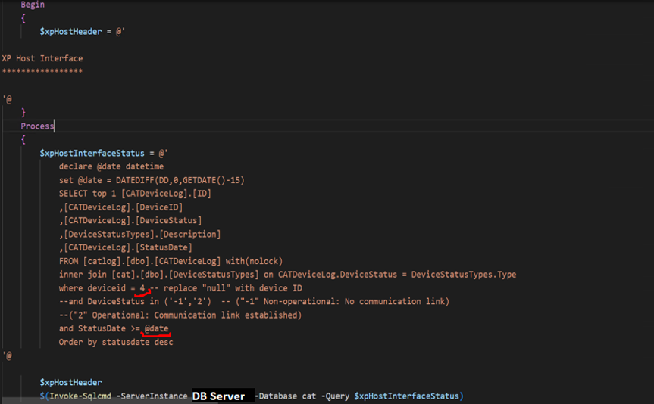
Invoke-LynxGateXpHostInterfaceStatus

Slide 26
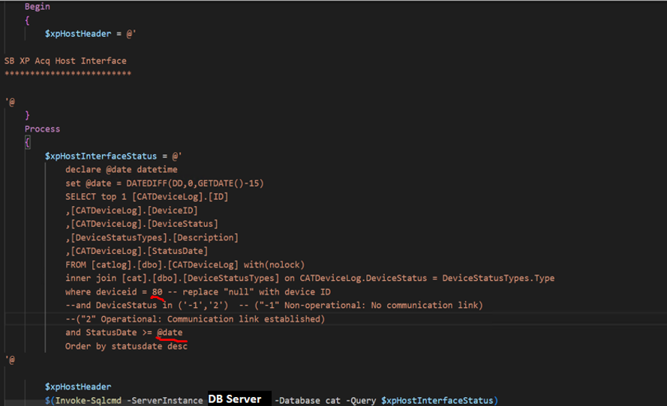
Invoke-LynxGateSBXPAcqHostInterfaceStatus

Slide 27
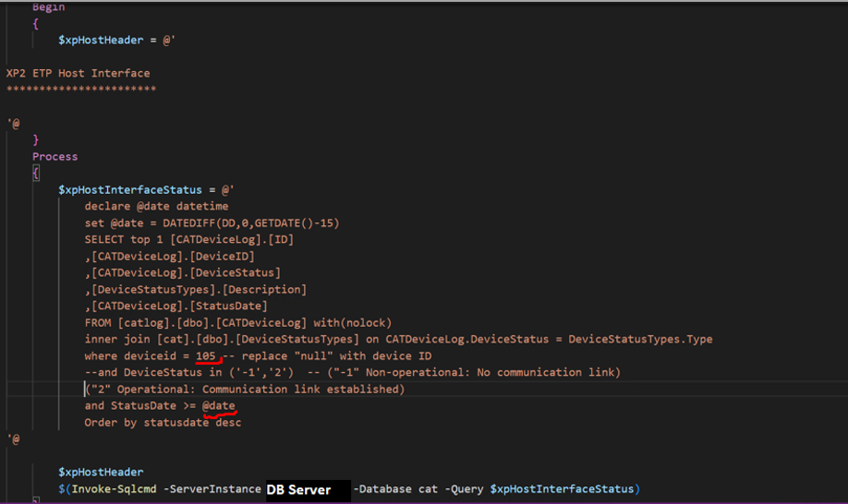
Invoke-LynxGateXp2ETPHostInterfaceStatus

Slide 28
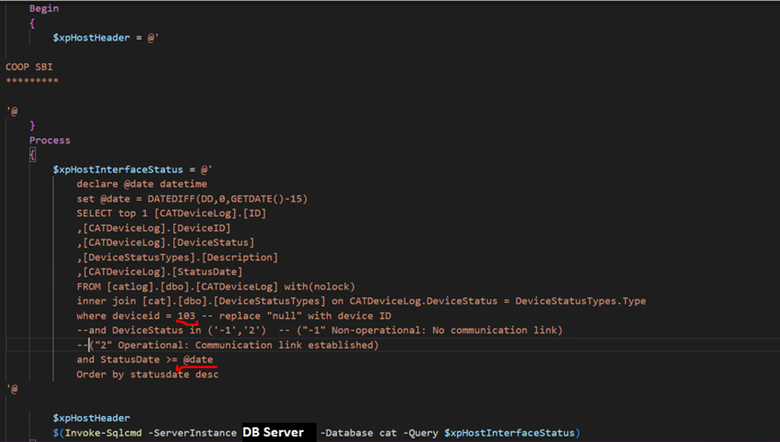
Invoke-LynxGateCOOPSBIStatus

Slide 29
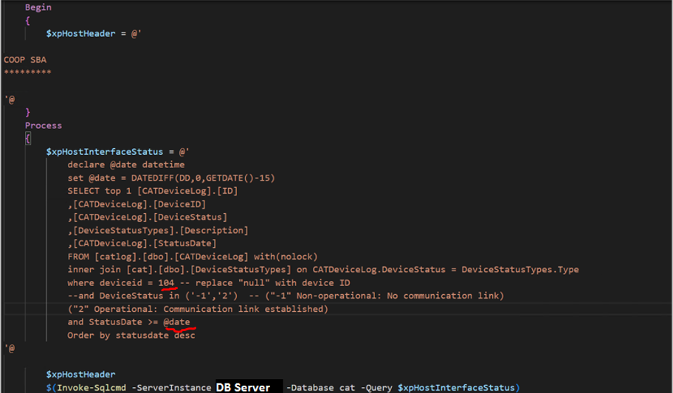
Invoke-LynxGateCOOPSBAStatus

Slide 30
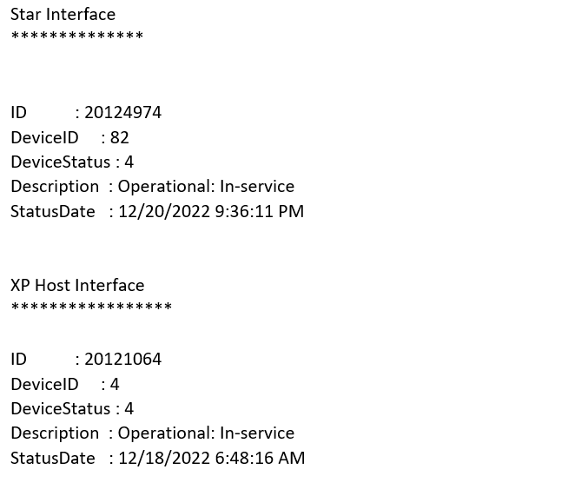
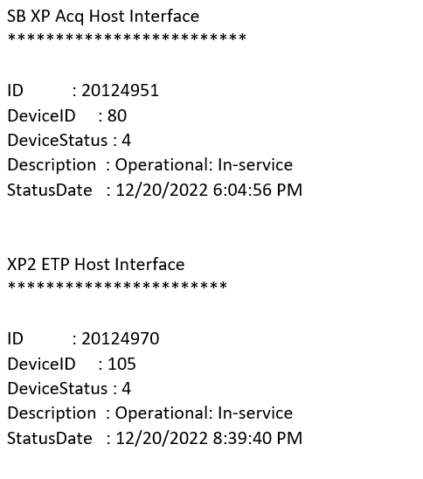
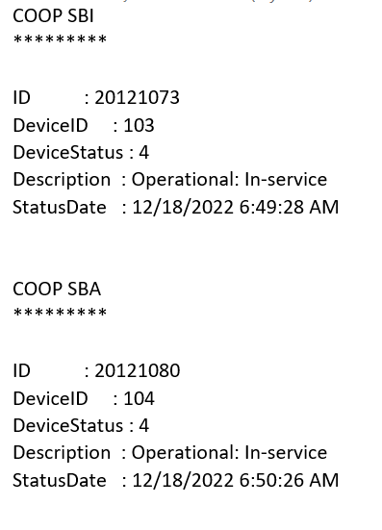
More Sample Emails

Slide 31
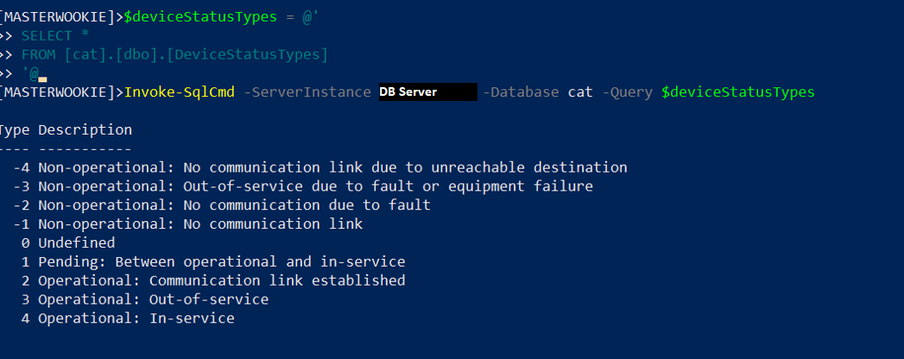
Device Status Types

Slide 32

Notification

Slide 33
PSHSummit2023Demo
Notes:
LynxGate Demo and LynxGate Top Demo

Slide 34
Call To Action
Create Modules instead of ps1 files
Consider using PS to connect to Database
Notes:
Better organization of functions and easier to test.
May be better to go directly to source to get data rather than using some other tool.

Slide 35
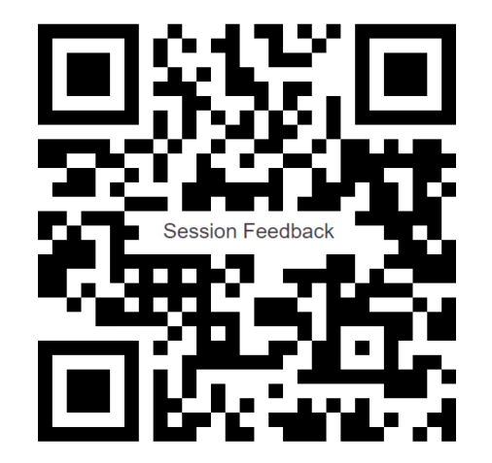
Thanks!
brucestump@gmail.com

